Slide 1
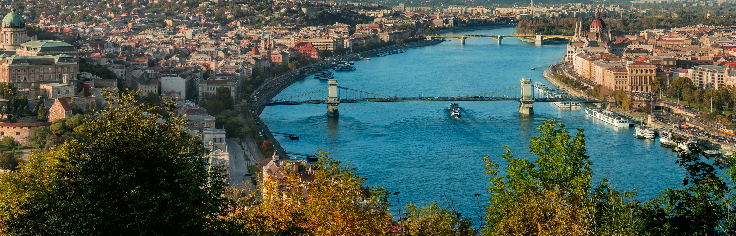
My City
Budapest
Bagaméry Zaránd 6.b

Slide 2
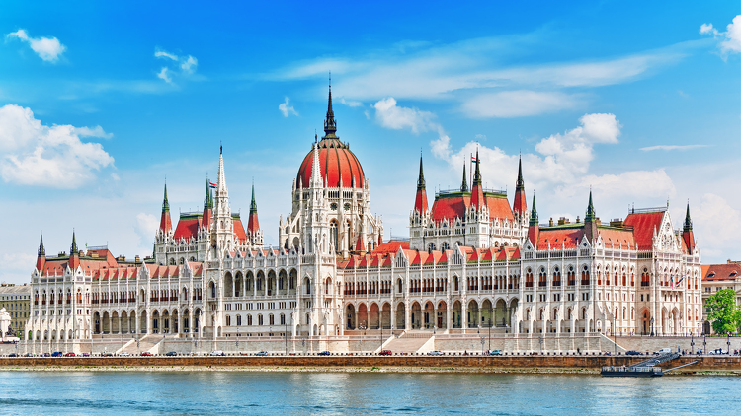
I live in Budapest, the capital of Hungary.
The Hungarian Parliament Building
1.752 million people live here.
There are lots of interesting things in Budapest.
One of these is the House of the Country.
The Parliament has meetings here.

Slide 3
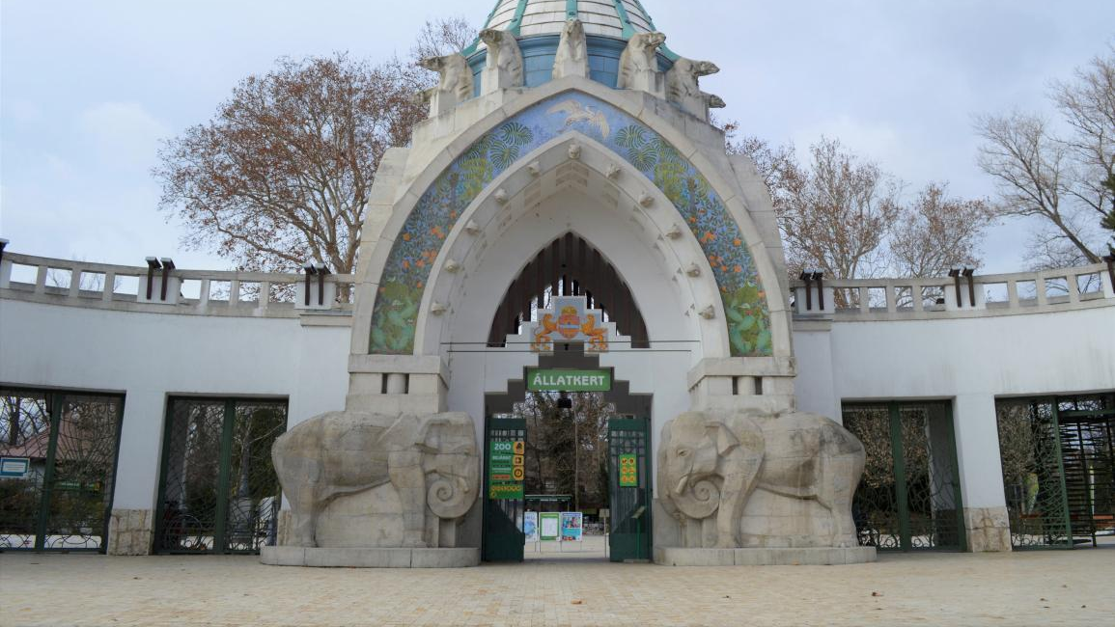
There is a Zoo in Budapest, with many animals. There are museums, theatres and cinemas in Budapest. Budapest has a Circus too.

Slide 4
The Danube flows through the city. There are several bridges over the Danube:
Árpád Bridge,
Margaret Bridge,
Széchenyi Chain Bridge,
Elisabeth Bridge,
Liberty Bridge,
Megyeri Bridge,
Petőfi Bridge,
Rákóczi Bridge.

Slide 5
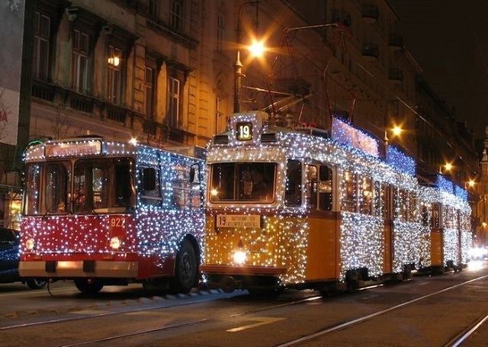
There are lots of shops, plazas and department stores.
Transport in Budapest is very complex.
There are metros, buses, trams, taxis and cars in the city.

Slide 6
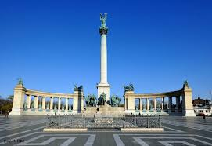
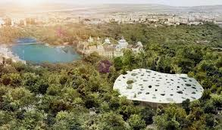
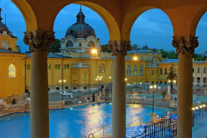
Heroes’ Square is very famous. There are 17 statues and 3 big ones.
The City Park is a big park. Children can go to the Crescent Park. People can train and run and they can also cycle. And there’s a lake, too. There are good restaurants, so you can spend the whole day here.
There are lots of spas and swimming pools in Budapest.
This is Széchenyi Bath. It is a big thermal spa.

Slide 7
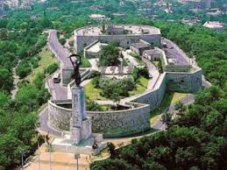
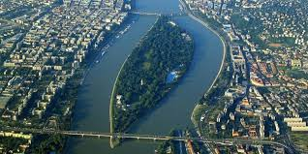
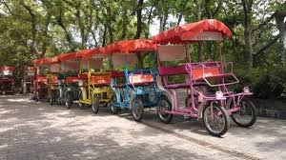
There are 3 famous hills in Budapest: János Hill, Széchenyi Hill and Gellért Hill.
The Statue of Liberty is a statue of a large female figure located on Gellért Hill, in Citadella fort.
One of the Danube’s islands is Margaret Island. Here you can walk, cycle, see the mini Zoo or rent a four-wheel bicycle.

Slide 8
Life on the Pest side is very lively and interesting. There are cafés, restaurants and a lot of other things to do.
Budapest consists of 23 districts. My favourite district is the XV.

