Slide 1
Money and Fashion
By: Laura Kiss, Brandy Lakatos, Levente Móré, Gergő Radácsy
Group 8/1

Slide 2
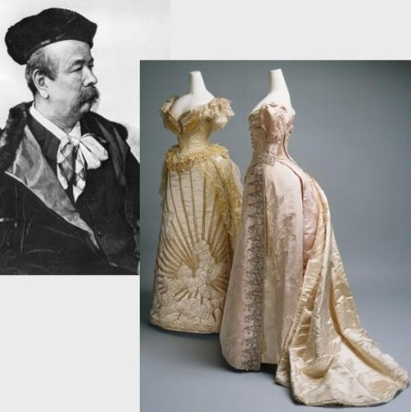
The starting of designer brands
The modern industry, based around firms or fashion houses run by individual designers, started in the 19th century with Charles Frederick Worth who,beginning in 1858,was the first designer to have his label sewn into the garments he created.

Slide 3
Ten of the most valuable fashion houses
10. Prada – $3.5 billion
9. Yves Saint Laurent – $3.6 billion
8. Dior – $4.7 billion
7. Burberry – $4.7 billion
6. Cartier – $6 billion
5. Rolex – $8.4 billion
4. Gucci – $25.3 billion
3. Hermès – $31 billion
2. Chanel – $37 billion
1. Louis Vuitton – $47.2 billion

Slide 4
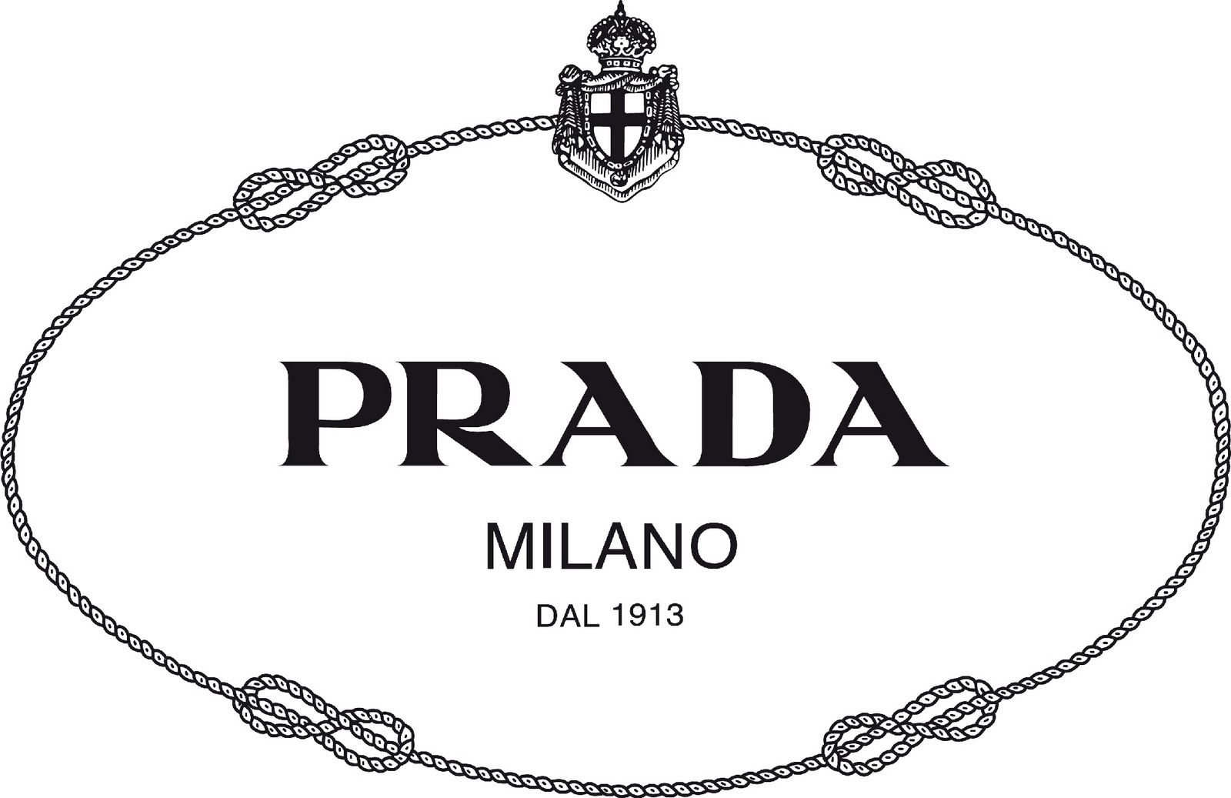
10. Prada – $3.5 billion
Founded by Mario and Martino Prada as the Fratelli Prada leather goods shop in Milan, Italy back in 1913, Prada is now one of the most well known luxury brands in the entire world. And its growth shows that, as the brand is worth no less than $3.5 billion today.

Slide 5
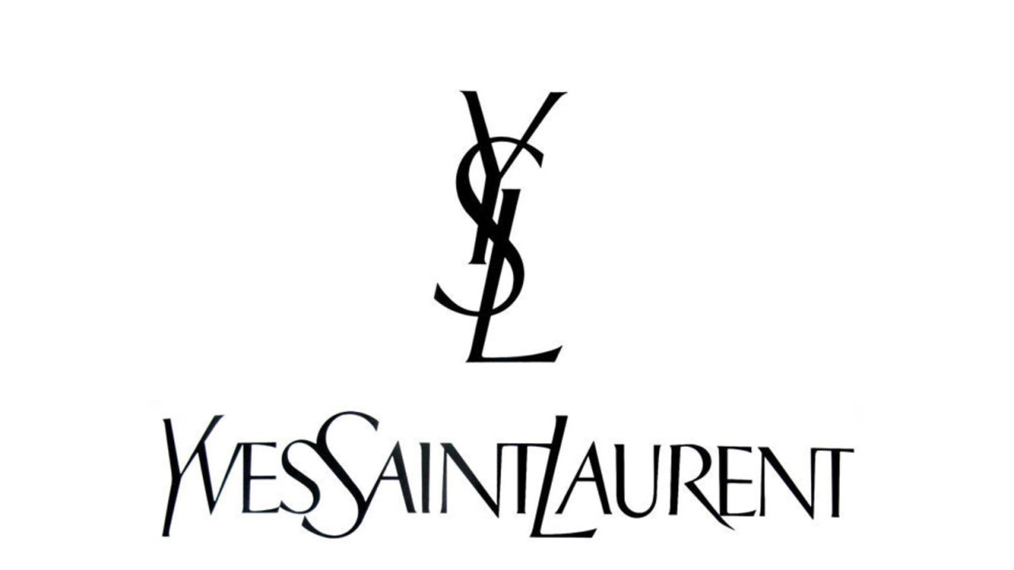
9. Yves Saint Laurent $3.6 billion
Also known as Saint Laurent, the French luxury fashion house Yves Saint Laurent wears its main founder’s name, who started the company in 1961 along with his partner Pierre Berge.
Yves Saint Laurent has for a long time been considered one of the world’s most prominent fashion houses, providing iconic men’s and women’s clothing pieces, along with leather goods, jewelry and shoes. Today, the brand has reached a value of no less than $3.6 billion.

Slide 6
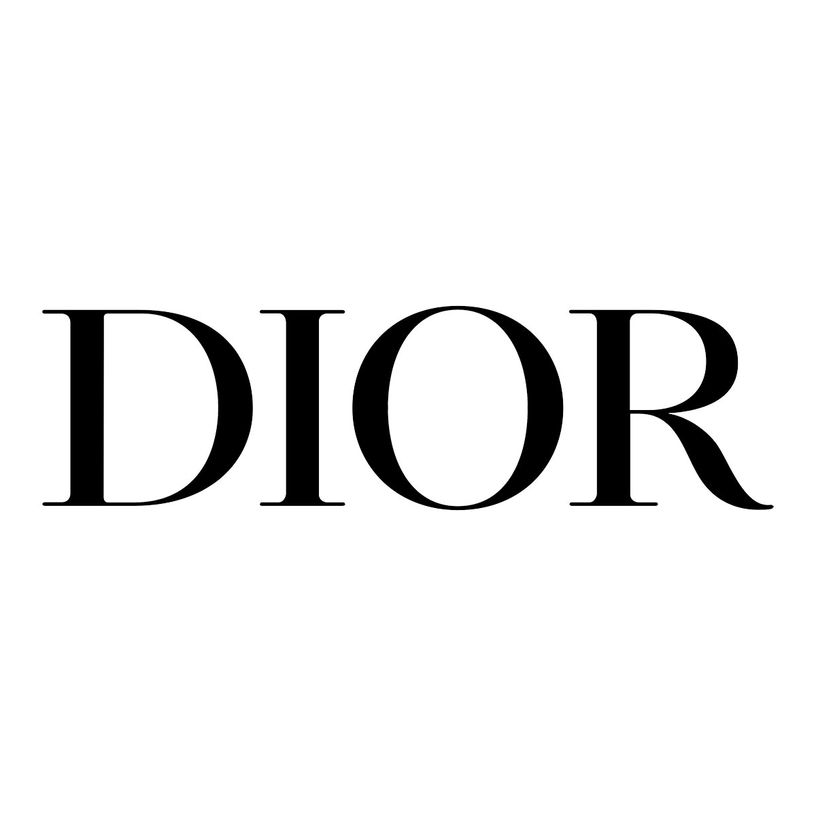
8. Dior – $4.7 billion
Christian Dior SE, more commonly known as simple Dior is yet another French luxury goods company which has debuted a long time ago and made it among the most cherished and biggest names in the fashion industry today. Founded by Christian Dior back in 1946, it’s now controlled by the French businessman Bernard Arnault, the one in charge of LMVH (Louis Vuitton Moet Hennessy), which you’ll find at the top spot.
Targeting mainly the female public, Dior sells fashion accessories, leather goods, luxury timepieces and jewelry, footwear, perfumes, makeup and skin care products. The brand’s value today reaches a good $4.7 billion, placing it eighth of the world’s most valuable luxury brands in 2019.

Slide 7
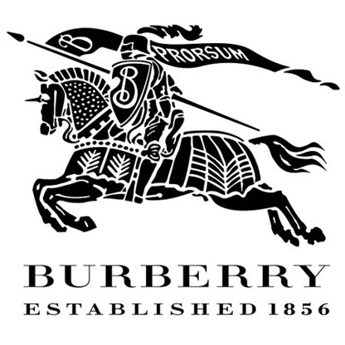
7. Burberry – $4.7 billion
Maybe less known than other names on this list, the British luxury fashion house Burberry, founded back in 1856 by Thomas Burberry in Basingstoke, England, started by creating outdoor attire before recently moving into the high fashion market.
Burberry is most known for the creation of the exclusive Gabardine, their own completely breathable and waterproof fabric. Other than that, they retail unique fashion accessories, pattern-based scarves and the iconic trench coats for which they are most famous. The brand is worth $4.7 billion as of this year.

Slide 8
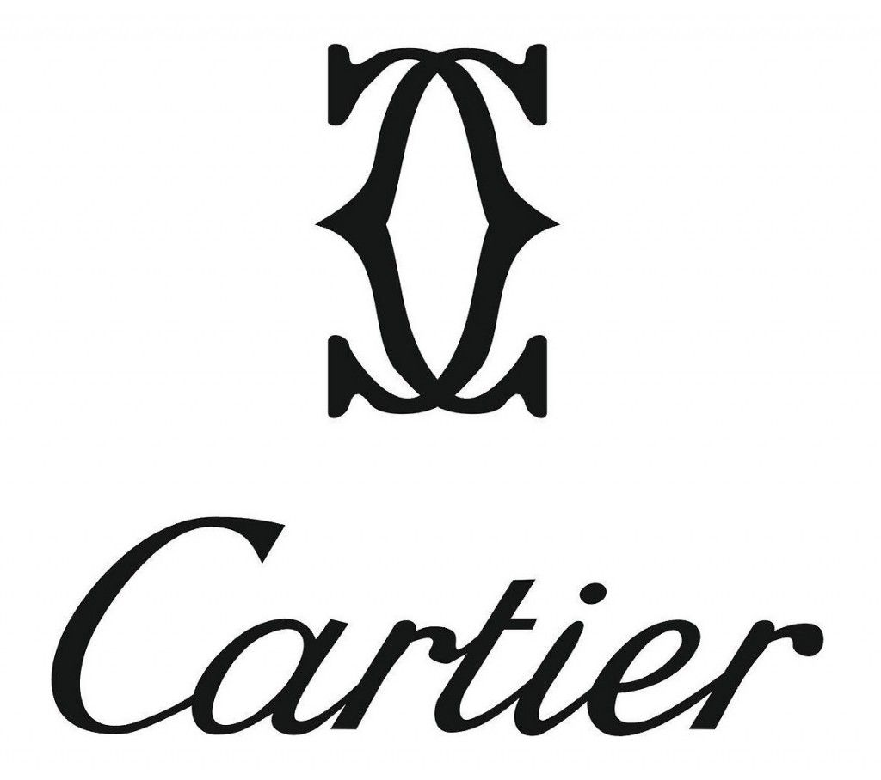
6. Cartier – $6 billion
Known world-wide for their iconic luxury watches and jewelry, Cartier is a French luxury goods conglomerate founded back in 1847 in Paris by Louis-François Cartier. With its headquarters in the French capital and over 200 stores in 125 countries, Cartier has reached world fame, situating itself among the most prestigious jewelry manufacturers in the world.
Last year, it was ranked by Forbes as the 59th most valuable brand in the world and this year, its total value has reached an impressive $6 billion.

Slide 9
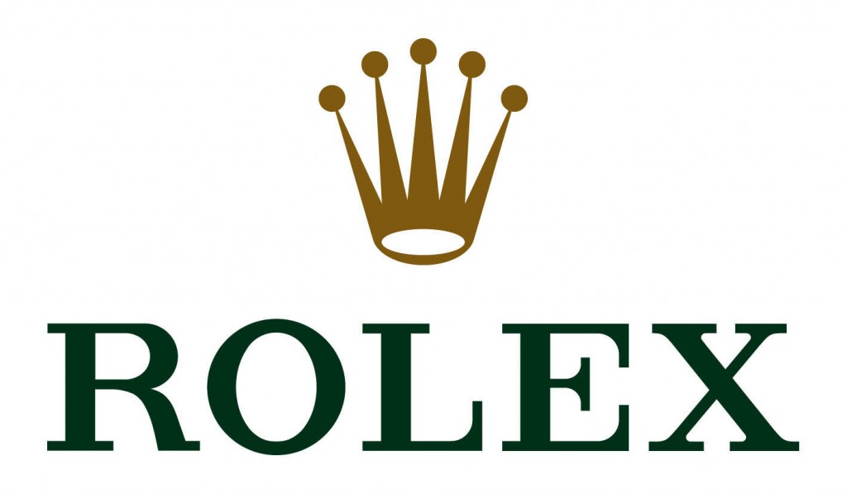
5. Rolex – $8.4 billion
Rolex, the ubiquitous Swiss luxury watch manufacturer is among the most valuable brands in the world, and number five in the high-end luxury market, worth no less than $8.4 billion today.
With its iconic timepieces, like the Paul Newman’s Rolex Daytona which holds the record as the most expensive wristwatch ever created, it’s no wonder that Rolex is on the tongues of almost anyone when it comes to luxury watches.
The company was founded in London in 1905 by Hans Wilsdorf and Alfred Davis, and was originally named Wilsdorf and Davis. Ten years later, it became Rolex Watch Co. Ltd. and after the First World War, it moved to Geneva, Switzerland, where it’s headquarters remained until present day.

Slide 10
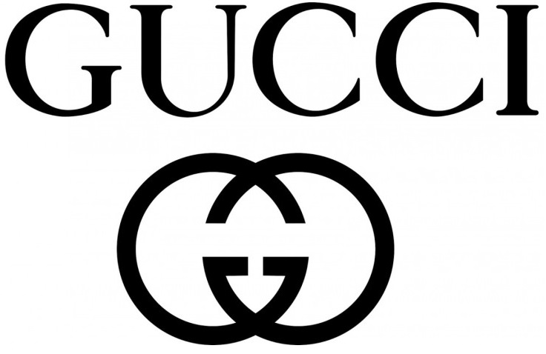
4. Gucci – $25.3 billion
Founded in 1921 in Florence, Tuscany by Guccio Gucci, the eponymous company is currently among the most famous fashion brands in the world, also ranked 38th most valuable brands in 2018 by Forbes. Gucci is also Italy’s top selling brand.
It has more than 278 stores worldwide, through which the brands sells its iconic fashion products like leather goods and clothing. As of this year, Gucci is valued at $25.3 billion, making it among the richest luxury fashion houses in the world today.

Slide 11
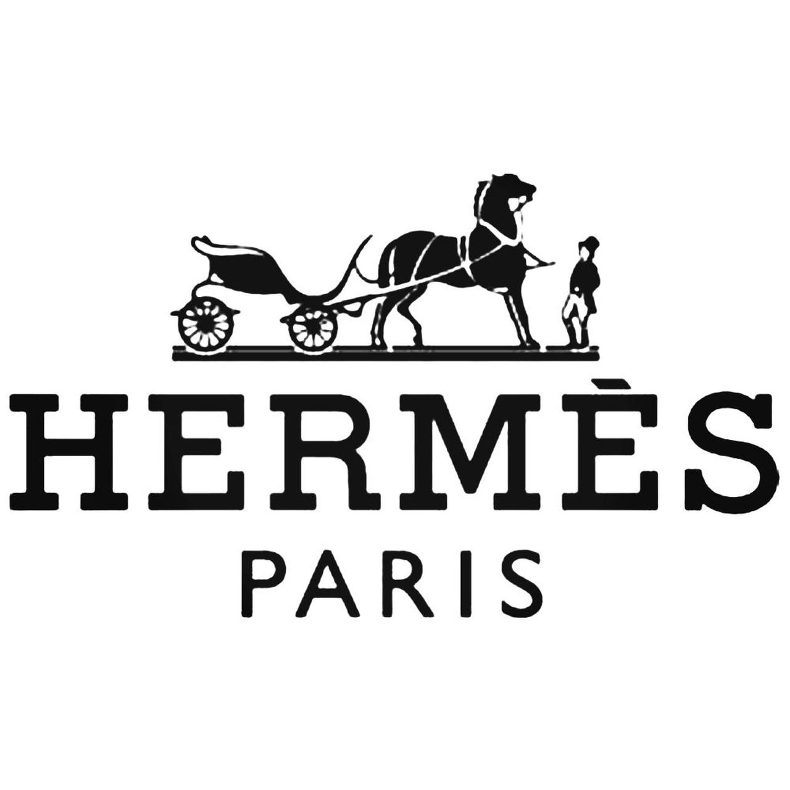
3. Hermès – $31 billion
Hermès International, or simply Hermès, is a French high fashion luxury goods manufacturer founded in 1837 by Thierry Hermès in Paris. Back then, it was just a simple harness workshop crafting high quality wrought harnesses and bridles for the high class of those times. Later on, the company began manufacturing saddles for the world’s elite, spreading their fame in Europe, the Americas, North Africa, Russia and Asia.
Unlike many companies today, Hermès is still owned by the Hermès family. It got through a decline in the 70’s after opening lots of shops worldwide, but managed to get back into the game mainly by keeping on working with natural materials as opposed to man made ones that other companies were using.

Slide 12
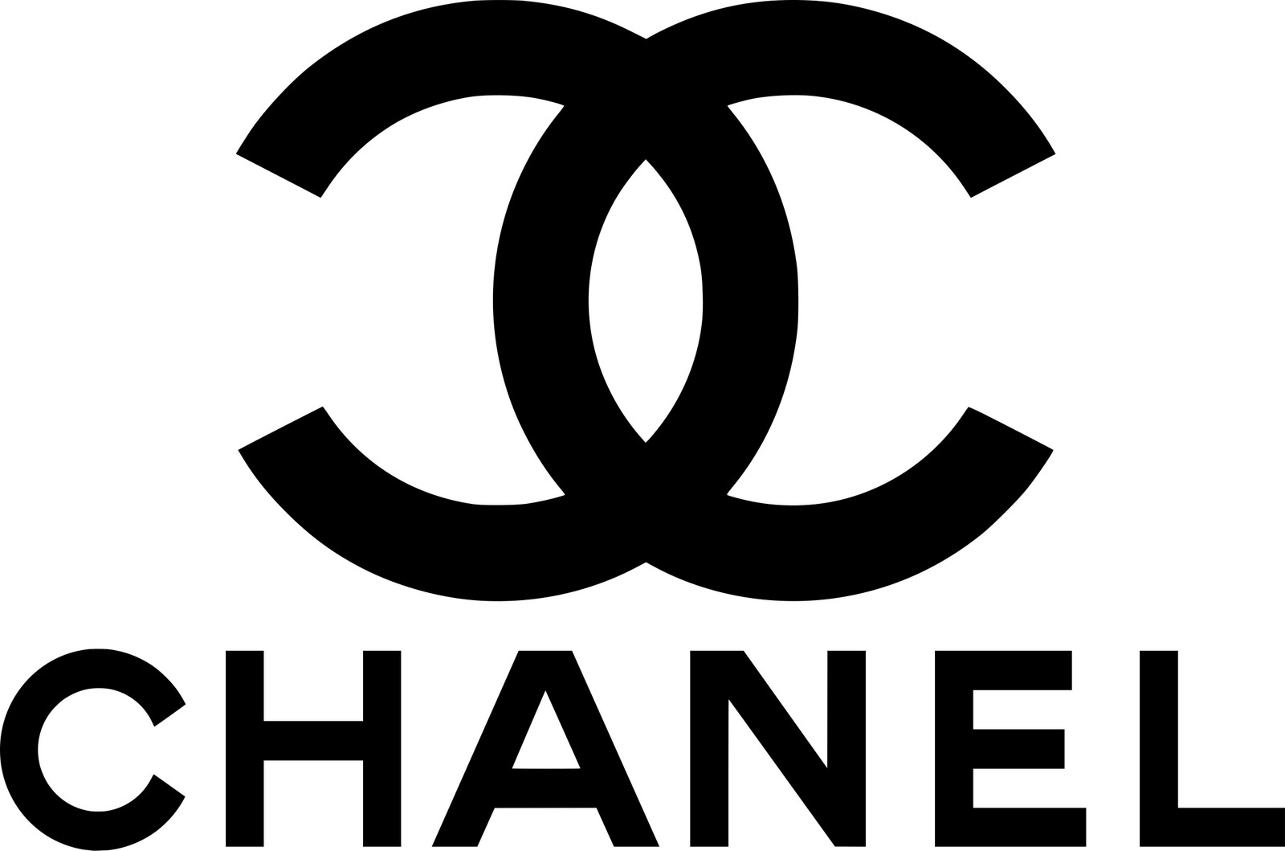
2. Chanel – $37 billion
Founded by the iconic Coco Chanel in 1909 as House of Chanel, the legendary high fashion house has become very well known in the world for its haute couture and luxury goods, especially its No. 5 de Chanel perfume, the ‘little black dress’ and the Chanel Suit.
What Chanel did that made them well known was to revolutionize the world of fashion, from high fashion to everyday wear. They replaced the old 19th century structured and constrictive garments like the corset with clothes that were a lot more functional while at the same time complimented a woman’s figure.
Today, the French fashion house Chanel is estimated to have a value of $37 billion.

Slide 13
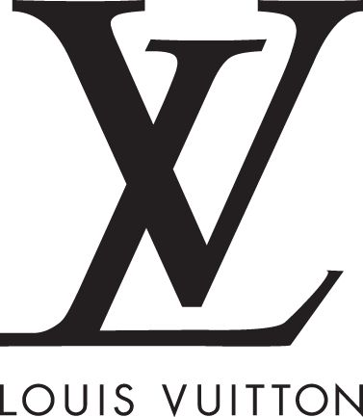
1. Louis Vuitton – $47.2 billion
Louis Vuitton Malletier, more commonly called Louis Vuitton or simply LV, is the most valuable fashion house today. With a growth of 15 percent last year, they’ve reached an impressive brand value of $47.2 billion. Between 2006 and 2012, it hold the title as the most valuable luxury brand in the world.
Founded in 1854 by Louis Vuitton, the French fashion house now operates more than 460 stores in over 50 countries of the world. One of their first products was the revolutionary Trianon canvas trunk, more lightweight and airtight than anything existent at that time and allowing the stacking of one on top of the other during travels.
Nowadays, they still handcraft their legendary luxury trunks, but also various other leather goods, footwear, watches, jewelry and accessories and their logo or monogram is widely recognized all over the world.

Slide 14
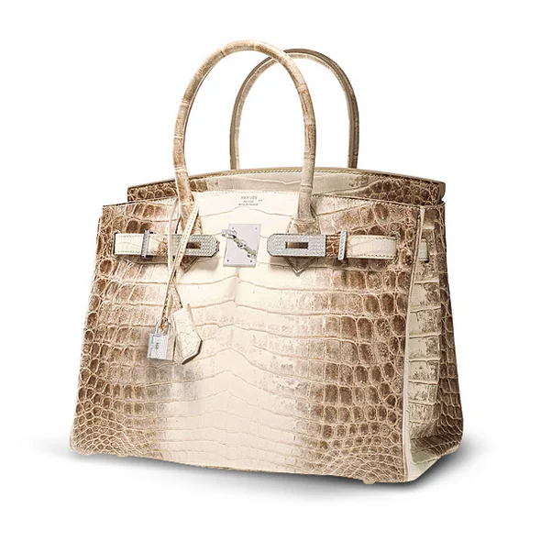
These are usually the most expensive pieces you can find on the market. They are made by hand, and very detailed. One of these things is the iconic, Hermes Himalayan Brirkin bag.​
These luxury brand stores can't be found in every mall you go to. They are usually in the towns were rich people live. Most people who go to these stores are regular clients. These VIP clients often get a private room full of the latest runway pieces. If they come to the store really often, and buy a lot of items, they get offered to special pieces, wich are not selled in the regular stores.
This particular one is the most expensive out of all of the models. It's made out of crocodile skin, and has white gold hardware covered with diamonds. It's retailed for $432,000.

Slide 15
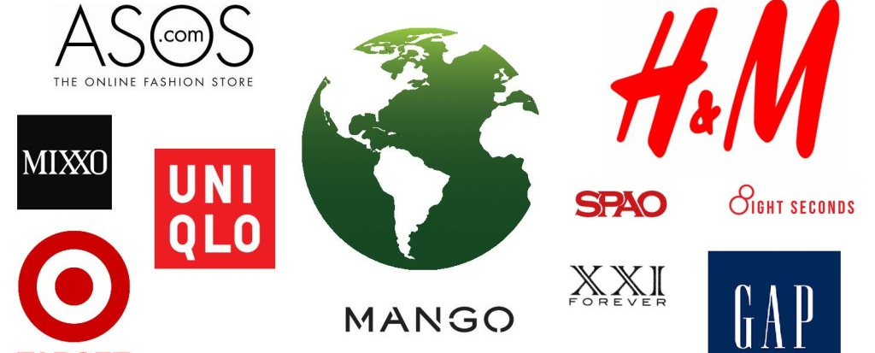
Fast Fashion

Slide 16
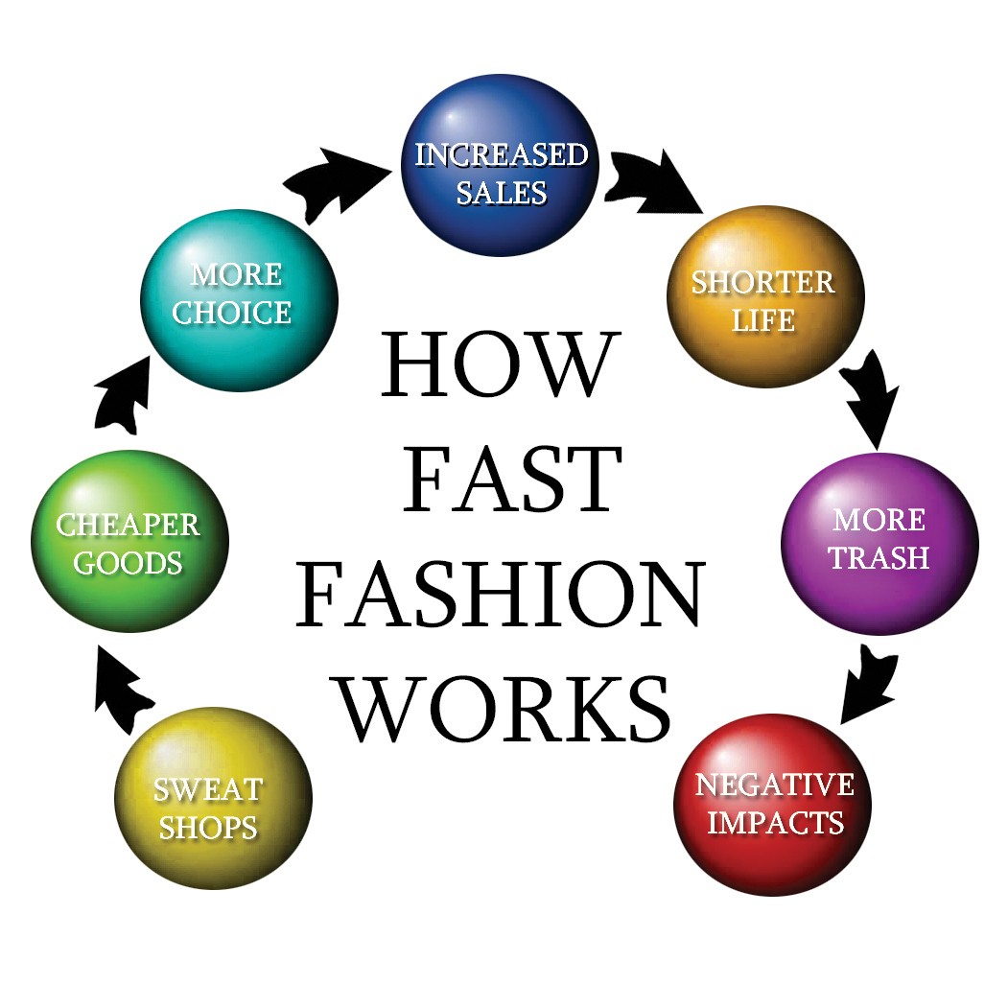
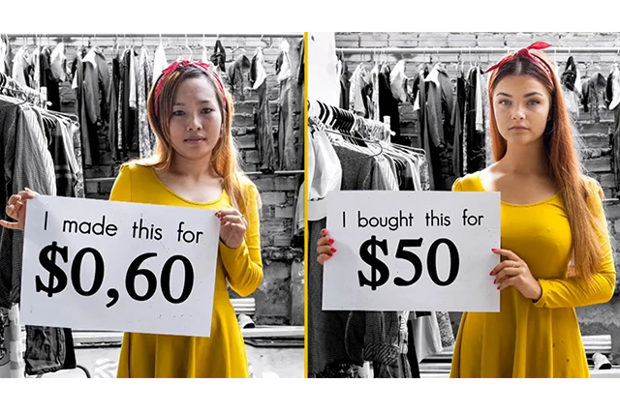
What Is Fast Fashion?
Fast fashion is the term used to describe clothing designs that move quickly from the catwalk to stores to meet new trends. The collections are often based on designs presented at Fashion Week events. Fast fashion allows mainstream consumers to purchase trendy clothing at an affordable price.
The explanation of fast fashion: https://www.youtube.com/watch?v=iq0--DfC2Xk

Slide 17
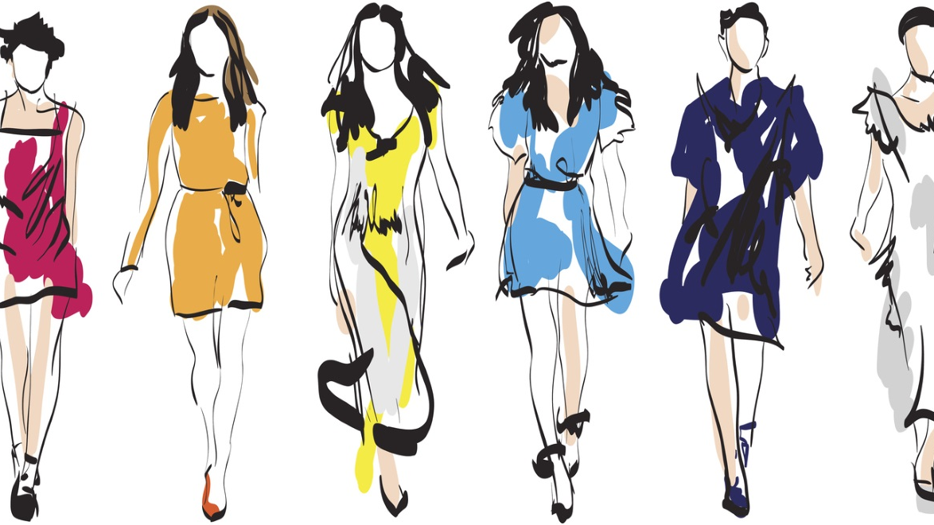
Fast fashion describes clothing designs that move quickly from the catwalk to retail stores to meet new trends.
Fast fashion competes with traditional fashion houses that continue to introduce new fashion lines on a seasonal basis.
Innovations in supply chain management among fashion retailers make fast fashion possible.
Leaders in the fast fashion industry include Zara, H&M, UNIQLO, Gap, and Forever 21

Slide 18
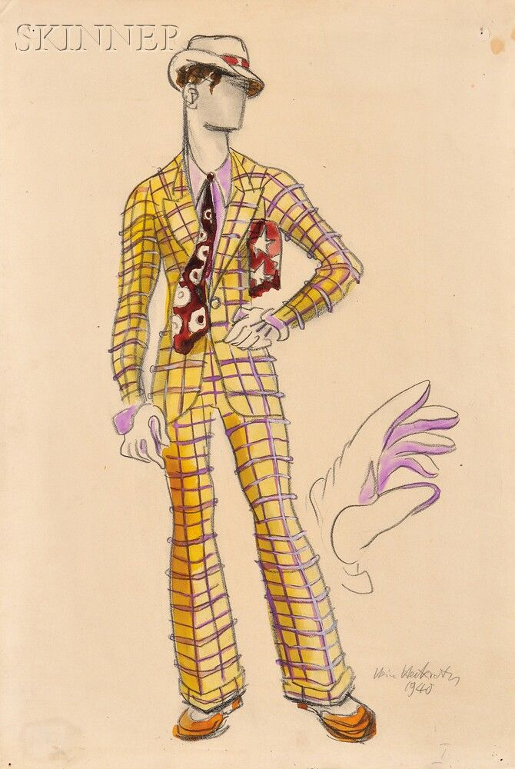
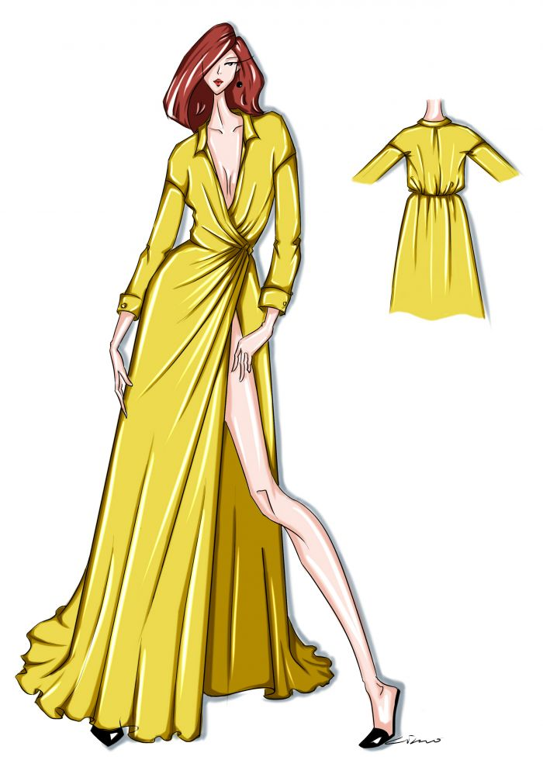
Avoiding fast fashion
We know that fast fashion is really bad for the enviroment, so how can we avoid it? Here are 3 tips that can help.

Slide 19
1. Buy boutique and avoid shopping fast fashion
If you love to shop in-person, you may want to check out some of your local boutiques. Chances are, you’ve avoided them because they can be a little bit on the pricey side. The reason for this is that small, privately owned boutiques usually have personal shoppers.
These personal shoppers locate local designers and distributors and personally select the clothes from that store.
As such, there’s no mass-production, and your profits directly benefit the owner, workers, and distributors of that store – as opposed to some bigwig at corporate headquarters.

Slide 20
2. Visit secondhand stores instead of shopping from fast fashion brands
Secondhand and thrift stores still get a bad rap after all these years, even though they’re perhaps the most sustainable way to shop and most effective way to avoid fast fashion.
We can’t do anything about the fast fashion pieces that are already in the world, so why not recycle them and use them to their maximum value?

Slide 21
3. Restore your existing clothes instead of divulging in fast fashion clothes
You don’t even need to spend more money if you have an already extensive wardrobe and are crafty. Simply breathe some life back into your existing clothes when you’re tired of them instead of throwing them away or opting for new ones.

Slide 22
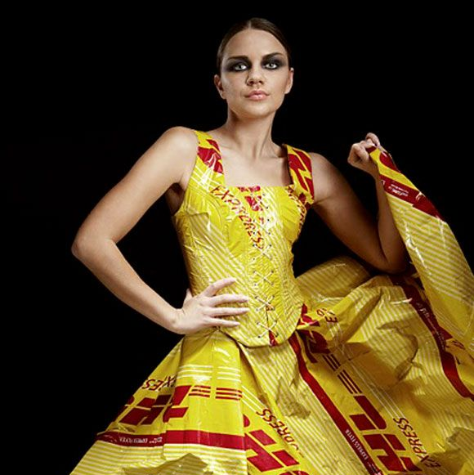
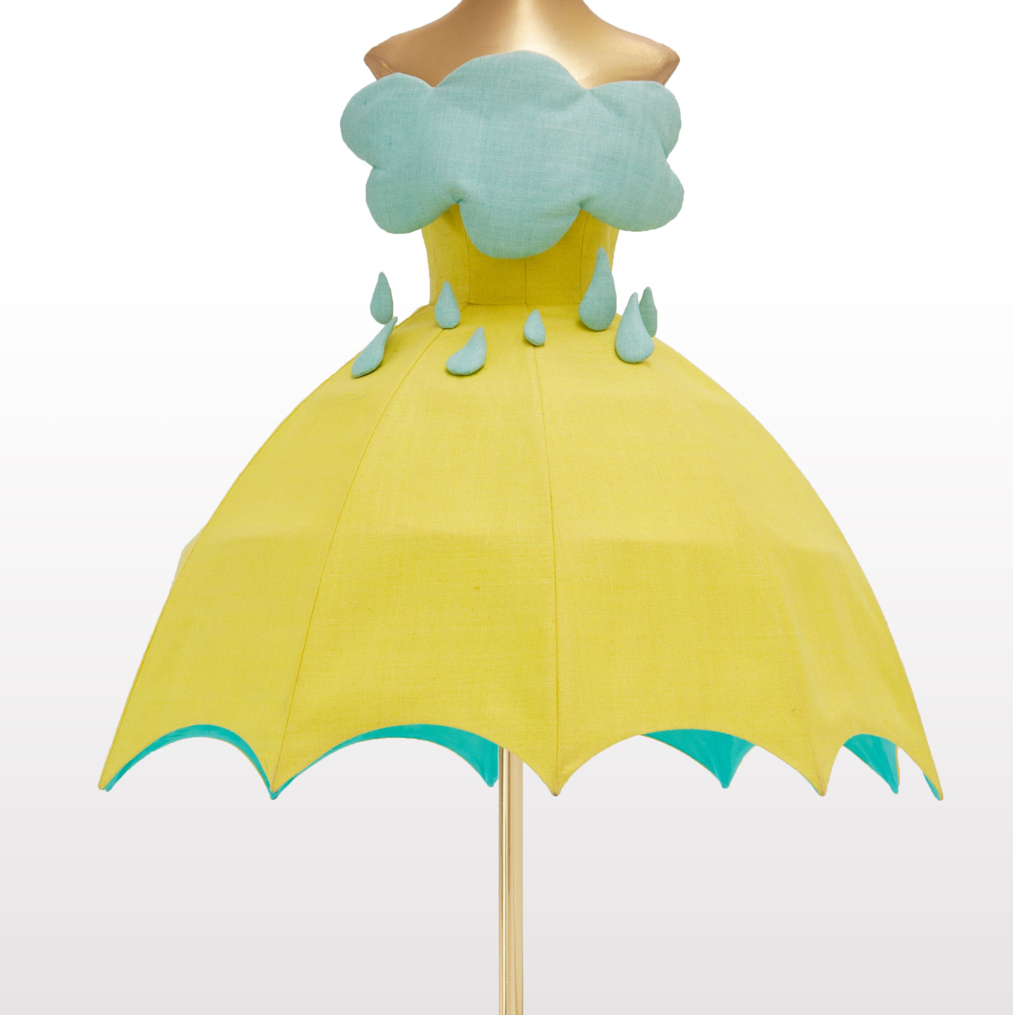
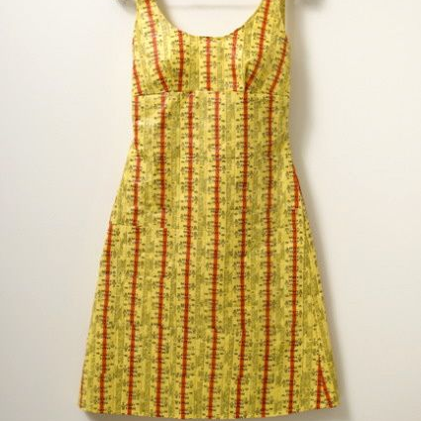
Here are three examples of recycled fashion pieces (with more of an editorial twist)

Slide 23
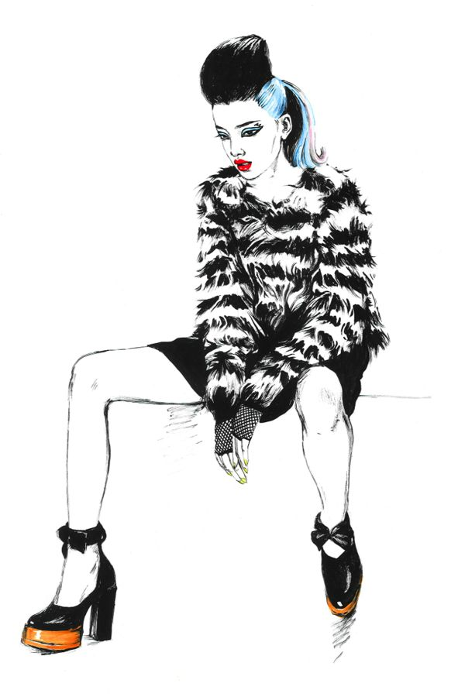
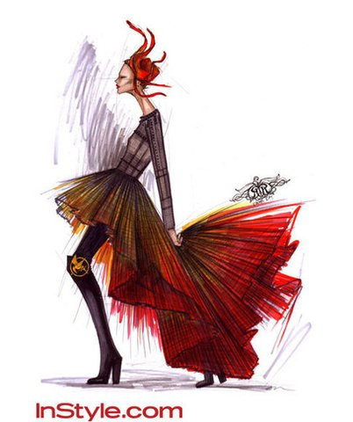
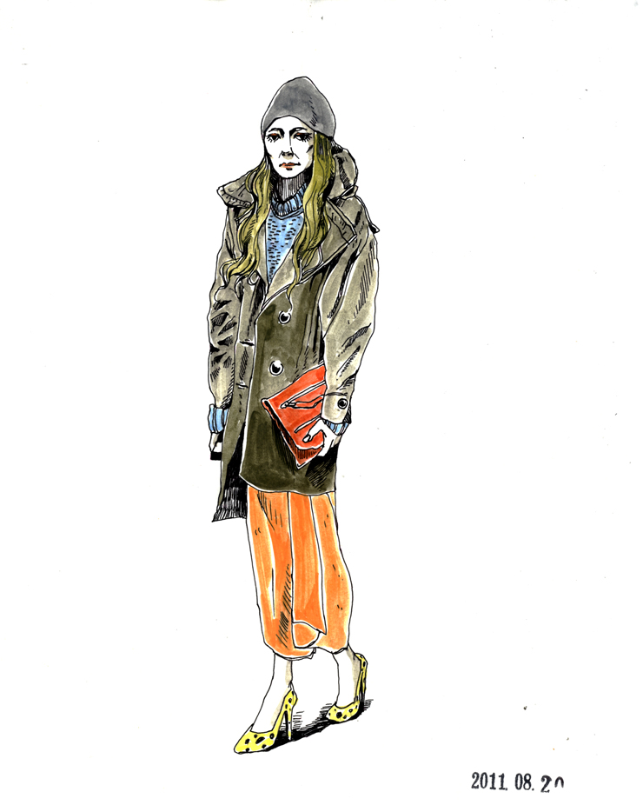
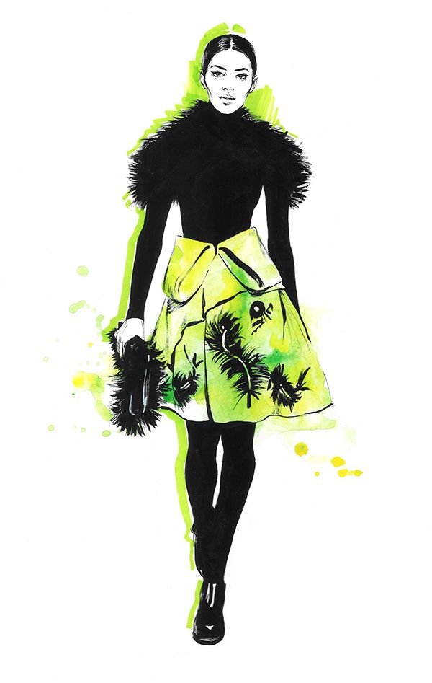
In fashion, “Editorial” would be a piece of clothing or an outfit that looks cool in a magazine, but isn’t necessarily wearable, and might attract weird stares if it were worn on the street.

Slide 24
Here are some famous models in editorial fashion:
Winnie Harlow for NORD magazine

Slide 25
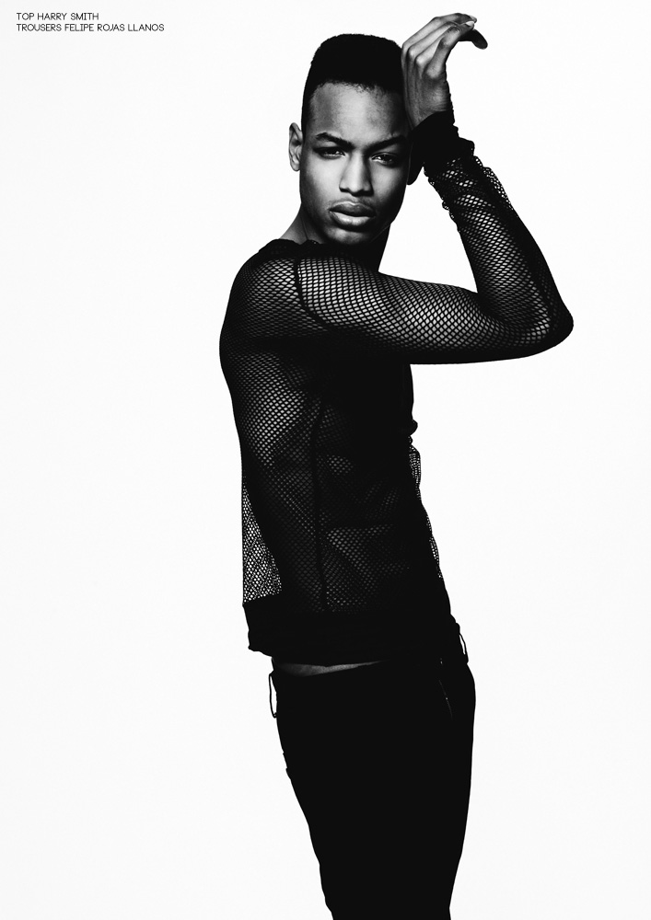
Conrad Bromfied for Male Model Scene

Slide 26
Barbara Palvin for Schon magazine.

Slide 27
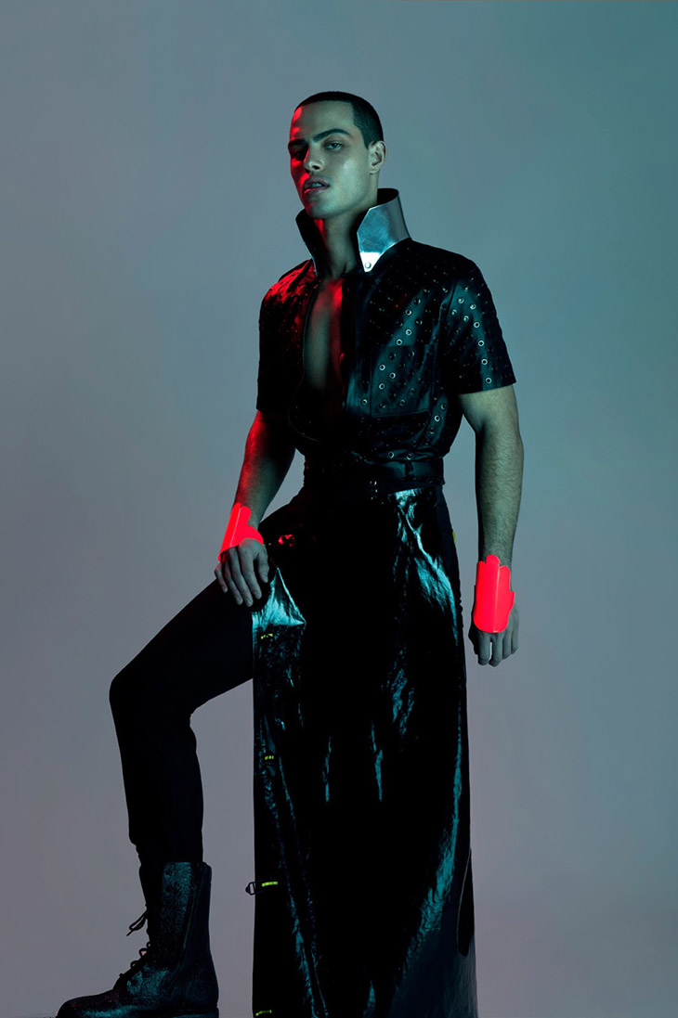
Zach Picotte for Bullett magazine

Slide 28
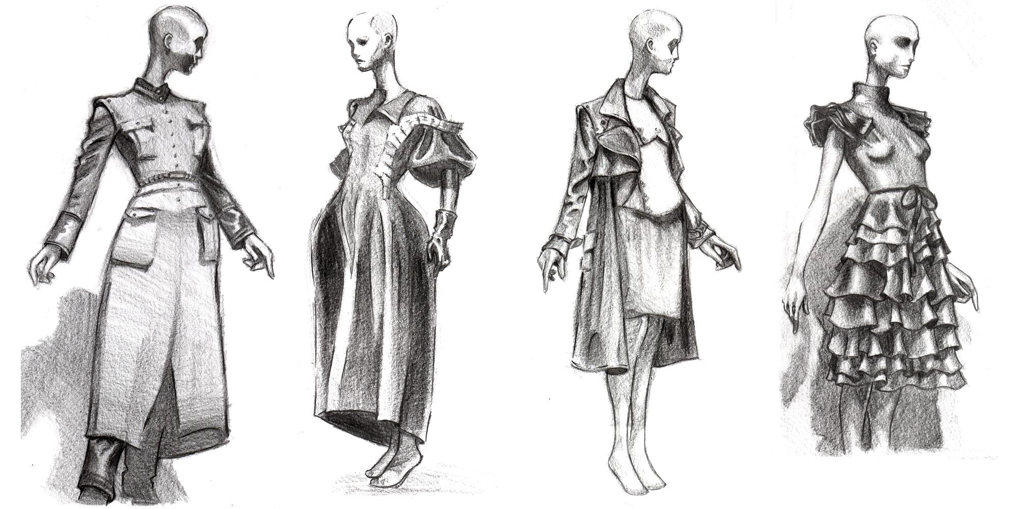
Every person has a diffrent opinion on fashion. All of us wrote a little composition as the closing part of this project. Here are them:

Slide 29
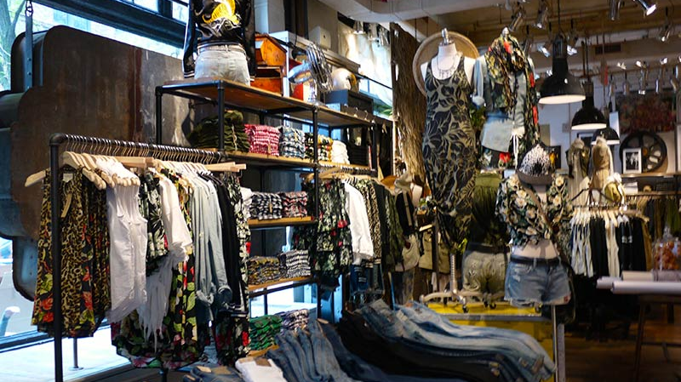
Levente Móré:
There would be nothing wrong with fashion by default. Smaller clothing brands are better in my opinion because they not only produce expensive clothes that can be taken up once, but also one that can be worn on a daily basis. The bad thing about fashion is that if you don’t wear clothes that don’t fit the fashion, a lot of people will humiliate you. For example, if you don’t have money for the dress or you don’t have a sense of fashion, they don’t even think you just don’t like it. So this is my opinion of fashion.

Slide 30
Laura Kiss:
I don’t follow the fashion trends, but sometimes I wear clothes which are trendy . A lot of my friends follow the fashion. I buy my dresses in following shops: H&M, New Yorker, Reserved. The prizes of the clothes in these shops are more expensive than in supermarkets and second-hand shops. The reasons of the higher prizes are the better quality and value of the brands.

Slide 31
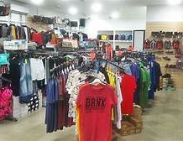
Gergő Radácsy:
I think fashion is overrated. Every year millions of people buy new fashionable clothes, and old fashion clothes are thrown away. Our environment are polluted because of buying new clothes. These fast fashion clothes are produced mostly in Asian countries by children who earn 1-2 USD for their work. So buying these clothes we support the producers to work like this. This is my opinion, and I don't follow the latest fashion, I prefer comfortable clothes.

Slide 32
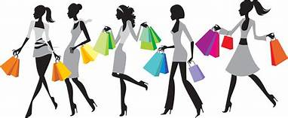
Brandy Lakatos:
I aways tried to follow fashion trends. I feel like that fashion is a really big part of your personality. People usally have a specific style that they stick to, like girly, tomboy,...ect. I feel like I don't really have a style that I stick to. I dress diffrent every day, just depends on my mood. It might be bc I haven't develloped mine yet. Anyway, I love to read about fashion in blogs, and I really want to invest in big fashion magazines like: Vogue, Elle, Harper's Bazaar,Marie Claire, Allure and many more. I watch fashion shows on youtube, and try to understand the meaning of the collection by watching fashion reviews, where they talk about the inspirations of the art, and how they created it. It's really interesting and diffrent. I hope that one day, I will be lucky enough to meet some of these designers, go on fashion week to see the latest collections, and maybe collaborate with them too.

Slide 33
Thanks for your attencion!

